Slide 1

PROJECT NO I
RAMAA DEVI S

Slide 2

Agenda
PROBLEM STATEMENT
UNDERSTANDING AND STEPS TO BE FOLLOWED
EDA
DATA CLENSING
DATA VISUALIZATION
CONCLUSION AND RESULT

Slide 3


Introduction
PROBLEM STATEMENT:
E-retail factors for customer activation and retention:
A case study from Indian e-commerce customers
Customer satisfaction has emerged as one of the most important factors that guarantee the success of online store; it has been posited as a key stimulant of purchase, repurchase intentions and customer loyalty. A comprehensive review of the literature, theories and models have been carried out to propose the models for customer activation and customer retention. Five major factors that contributed to the success of an e-commerce store have been identified as: service quality, system quality, information quality, trust and net benefit. The research furthermore investigated the factors that influence the online customers repeat purchase intention. The combination of both utilitarian value and hedonistic values are needed to affect the repeat purchase intention (loyalty) positively. The data is collected from the Indian online shoppers.
Results indicate the e-retail success factors,
which are very much critical for customer satisfaction

Slide 4

Topic one
UNDERSTANDING ANd STEPS TO BE FOLLOWED
After reading the above problem statement completely and clearly, we can come to a decision that we have to take the dataset into evaluation regarding its depentant and independant variables and find the most customer satisfied Indian online shopping website to be recommended.
For that ,the following steps to be followed:
Subtitle

Slide 5
1)importing needed libraries
2)getting the dataset
3)EDA-Exploratory Data Analysis -- dtypes,isnull() ...etc
4)Data clensing -- transforming dtypes
5)Data Visualization- using matplotlib and seaborn
TILL THIS STEP WE CAN EASILY PREDICT THE MOST SATISFIED AND RECOMMENDED INDIAN ONLINE WEBSITE BY MOST CUSTOMERS .
But the following steps needed to find the BEST FITTED MODEL for the given dataset.
6)More EDA -- describe, correlation
7)More data clensing by removing some unnecessary columns.
8)Removing OUTLIERS
9)Spliting the data as x and y
10)Balancing them
11)Training and Testing of them
12)Regression or Classification
13)Prediction of models
14)Hypertuning of models( This is not needed in this dataset as we get the accurate model before this step
15)Saving the model

Slide 6

import pandas as pd import numpy as np import warnings warnings.filterwarnings('ignore')
IMPORTING THE NEEDED LIBRARIES

Slide 7
GETTING THE DATASET
df=pd.read_csv('customer_retention_dataset.csv')
df
EDA -- Exploratory Data Analysis
df.columns
df.dtypes
df.isnull().sum()

Slide 8
DATA CLENSING
df['Which of the Indian online retailer would you recommend to a friend?'].value_counts()
import sklearn
from sklearn.preprocessing import OrdinalEncoder
ordin=OrdinalEncoder()
ordin.fit(df)
For better evaluations and prediction we have to transform the object data type into int or float.
for i in df.columns:
if df[i].dtypes=='object':
df[i]=ordin.fit_transform(df[i].values.reshape(-1,1))
df

Slide 9
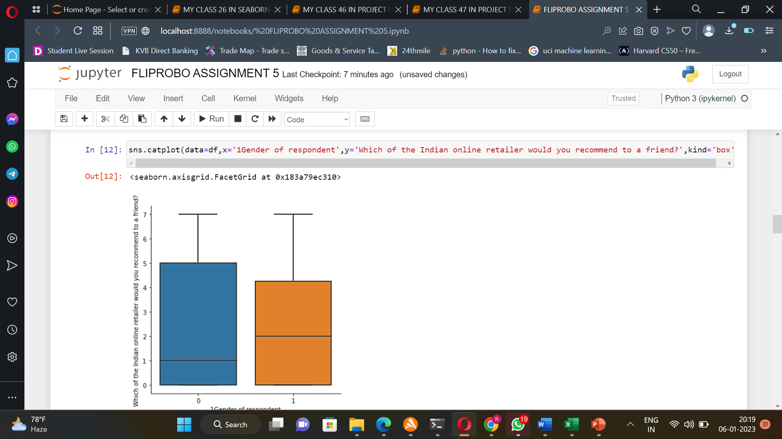
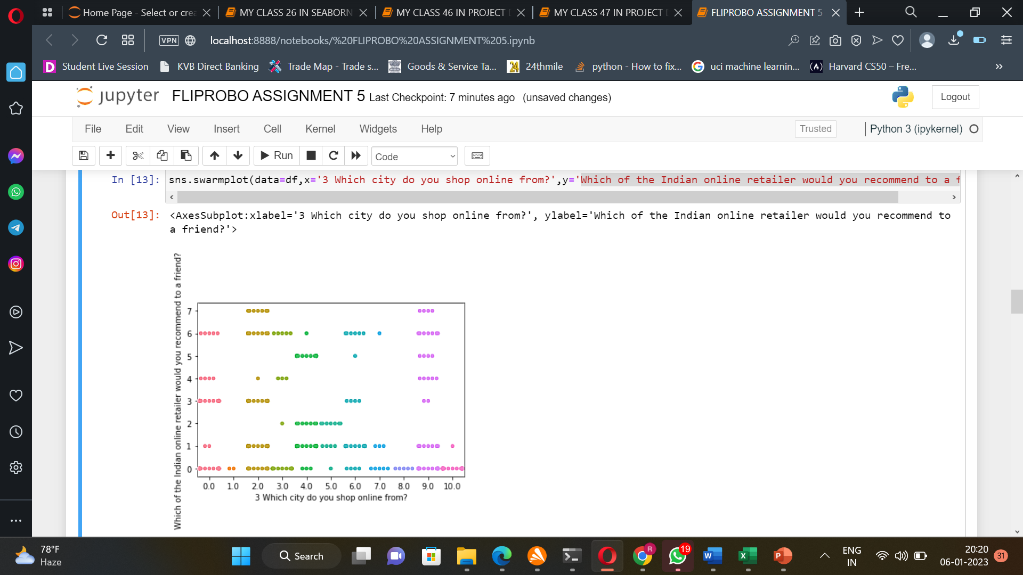
DATA VISUALIZATION
BOX PLOT
SWARM PLOT

Slide 10
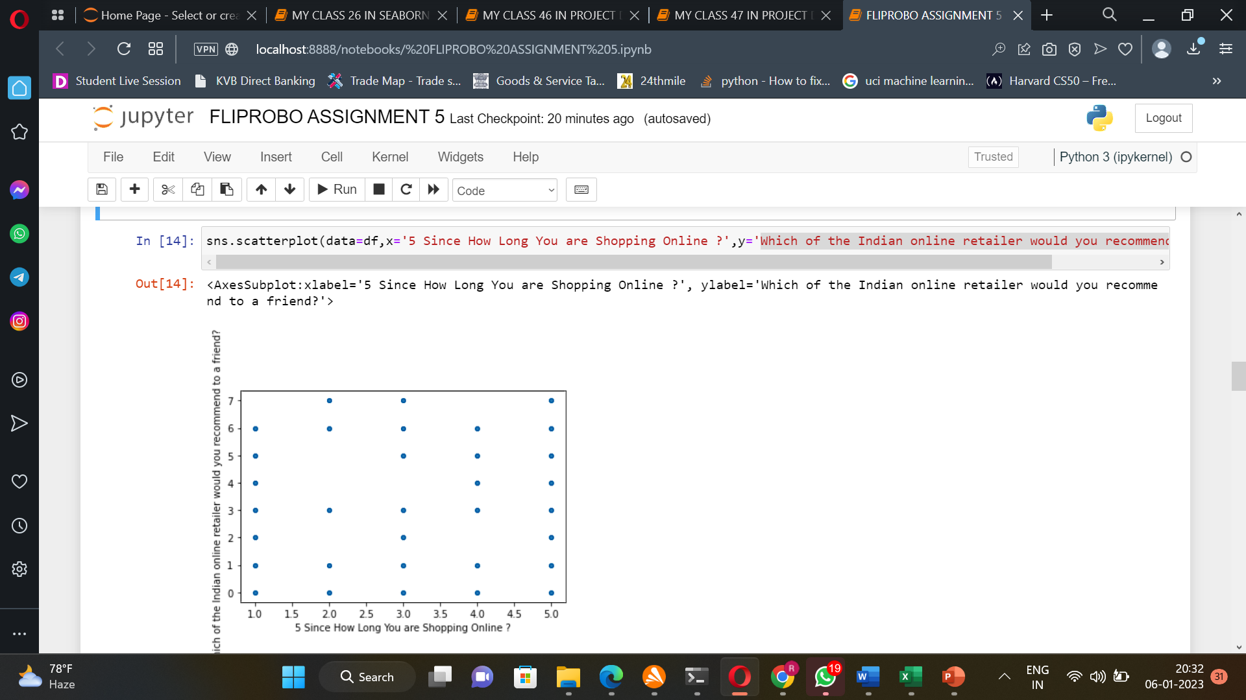
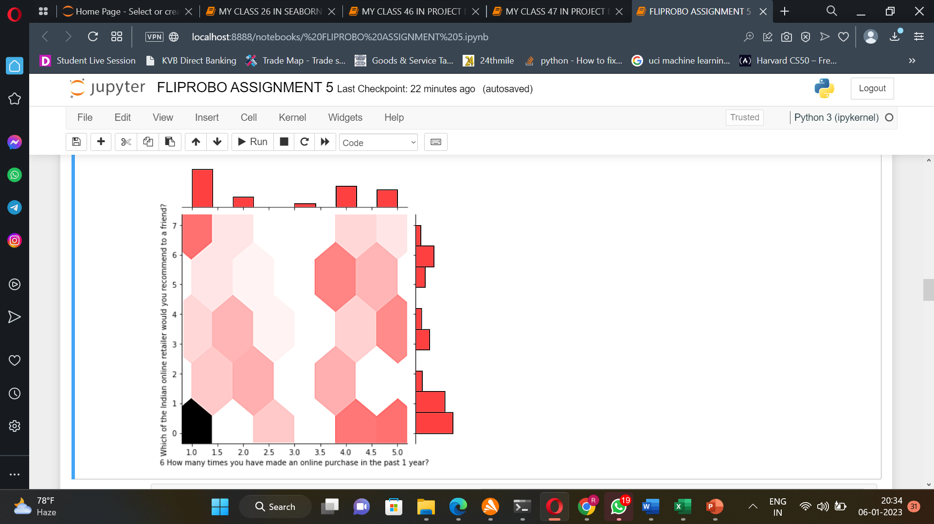
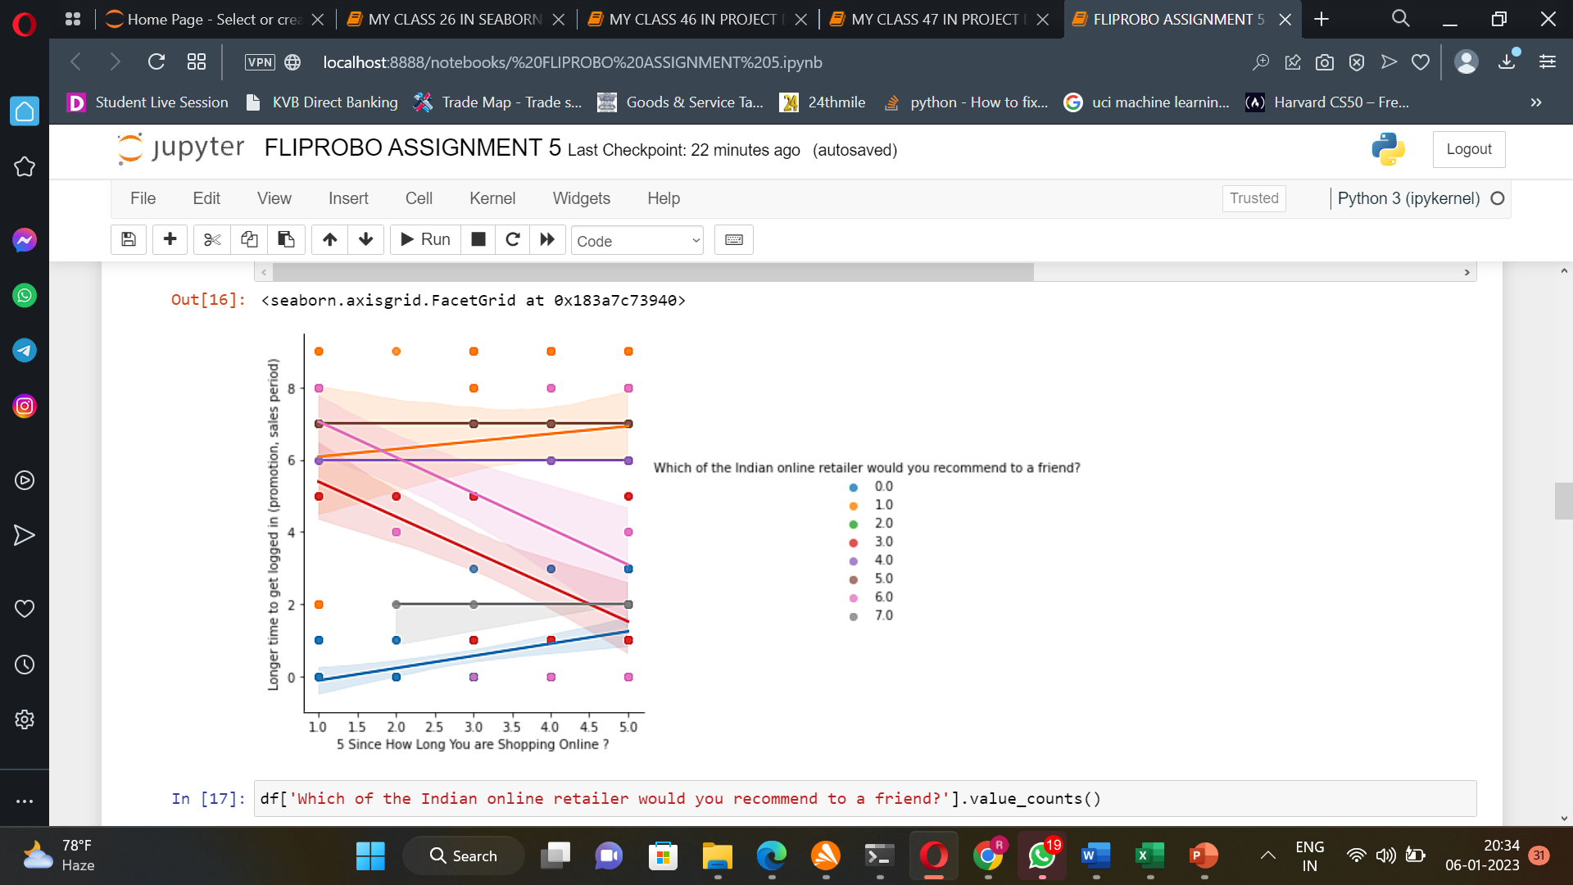
DATA VISUALIZATION(CONTINUED)
SCATTERPLOT
JOINT PLOT
LMP PLOT

Slide 11
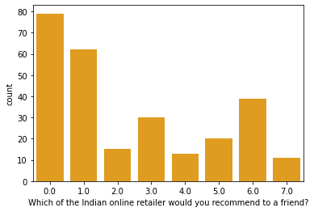

This gives the study that about: 79% percent customers are satisfied and recommend with AMAZON.IN 62% percent customers are satisfied and recommend with AMAZON.IN and FLIPKART.COM 39% percent customers are satisfied and recommend with FLIPKART.COM 30% percent customers are satisfied and recommend with AMAZON.IN and MYNTRA.COM 20% percent customers are satisfied and recommend with AMAZON.IN,PAYTM.COM and MYNTRA.COM 15% percent customers are satisfied and recommend with AMAZON.IN,FLIPKART.COM and MYNTRA.COM 13% percent customers are satisfied and recommend with AMAZON.IN and PAYTM.COM 11% percent customers are satisfied and recommend with FLIPKART.COM,PAYTM.COM,MYNTRA.COM and SNAPDEAL.COM From the above study , it reveals that amazon.in seperately and partnering with other sites gives nearly more than 95% percent of customer satisfaction and also to be much recommended by them
SUMMARY
RESULT :¶
MOST SATISFIED INDIAN ONLINE RETAILER IS :
AMAZON.IN

Slide 12


THANK YOU
RAMAA DEVI S
elangidevi@gmail.com
Internship34

